Slide 1
PHYS 111 Experiment 5 Dynamics of Circular Motion (Centripetal Force)
Fall 2020

Slide 2
Dynamics of Circular Motion
A centripetal force is a force that causes an object to move in a circular path.
If we stick to an inertial reference frame, Newton’s laws of motion give us all that we need to understand this circular motion.
Notes:
We can use the second bullet point to initiate a discussion amongst the students: Can an instrument reduce systematic error? If so, in what cases? Can an instrument reduce random error? If so, when and how?

Slide 3
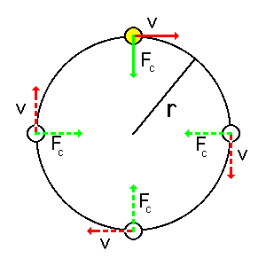


Dynamics of Circular Motion
Centripetal acceleration $a_{rad}$ is directed towards the center of the circle
$$a_{rad}=\frac{v^{2}}{R}=ω^{2}R$$
where ω is the angular velocity,
$$ω=\frac{v}{R}$$

Slide 4
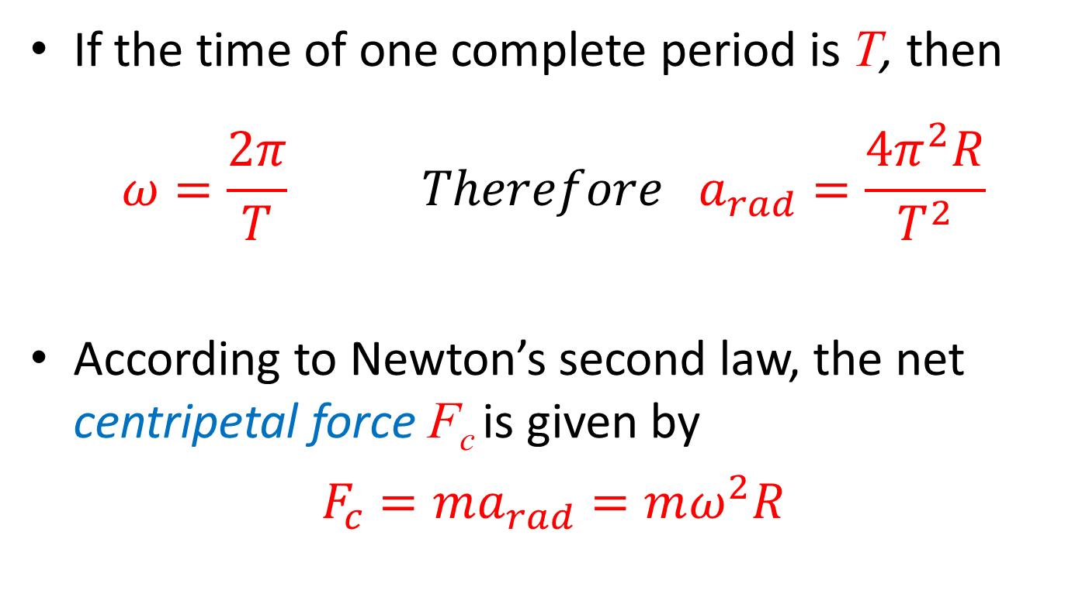
Dynamics of Circular Motion
If the time of one complete period is T, then
$$ω=\frac{2π}{T} Therefore a_{rad}=\frac{4π^{2}R}{T^{2}}$$
According to Newton’s second law, the net centripetal force F_{c} is given by
$$F_{c}=ma_{rad}=mω^{2}R$$

Slide 5

Experimental setup
Cobra 4 Force Sensor-Unit
Rotating cart track
Movable cart
Belt
Laboratory motor

Slide 6
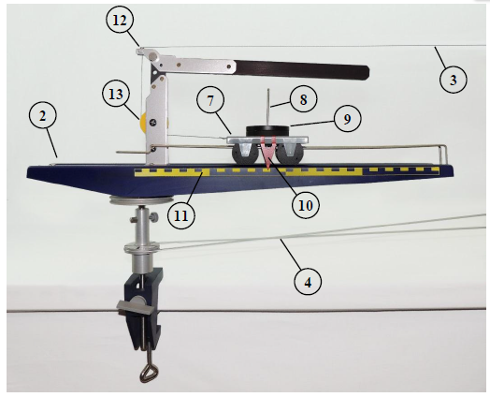
Determination of the angular velocity of the cart
The output force vs. time graph will have a sinusoidal behaviour.
Why?
When the cart track (2) is rotating, the eye (12) moves slightly back and forth, causing the circular path radius to change slightly (about the adjusted radius) during the circular motion (Recall that 𝐹 ∝𝑅 𝑎𝑡 fixed 𝜔).
Notes:
This eccentricity (deviation from the center) of the eye is intentional as it allows the determination of the angular velocity of the cart track as will be shown later.

Slide 7




Tasks
Investigate the relation between the centripetal force and the mass of the body.
Investigate the relation between the centripetal force and the angular velocity of the rotating mass.
Investigate the relation between the centripetal force and the radius of the circular path.
$$ω$$
$$m$$
$$F_{c}$$
$$F_{c}=mω^{2}R$$
Notes:
This eccentricity (deviation from the center) of the eye is intentional as it allows the determination of the angular velocity of the cart track as will be shown later.

Slide 8
Objectives of Experiment 5
Learn about the parameters of the uniform circular motion of a body (centripetal force, tangential velocity, angular velocity, centripetal acceleration).
Verify the relation between the centripetal force and
- the mass of the body.
- the angular velocity of the rotating mass.
- the radius of the circular path.
Notes:
Objectives

